Slide 1
COVID-19 PREDICTION MODEL
MODEL USED:
LINEAR REGRESSION
BY: YASHASWINI NAGARAJAN

Slide 2
RESULTS CONCLUDED BY DOING UNIVARIATE ANALYSIS
On observing the histograms I could make out some features have constant values so they will not have any relation with other quantities. Those features are listed below:
population
population density
median_age
aged_65_older
aged_70_older
gdp_per_capita
extreme_poverty
cvd_death_rate
diabetes_prevalence
female_smokers
male_smokers
handwashing_facilities
hospital_beds_per_thousand
life_expectancy

Slide 3
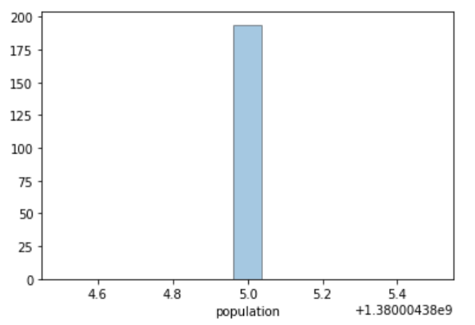
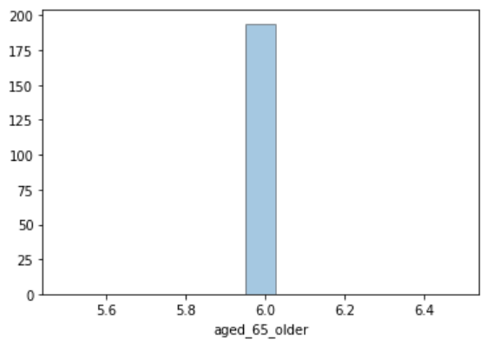
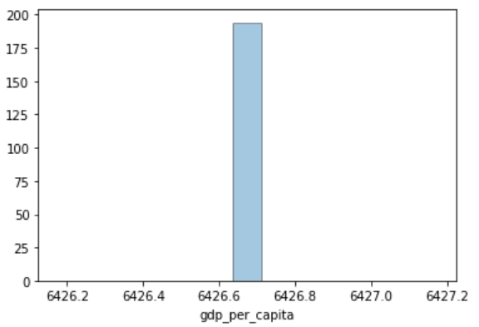
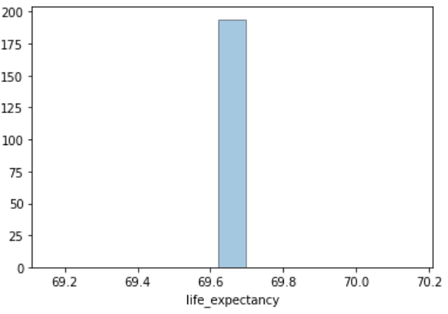
The graphs of some of those features are given below:

Slide 4
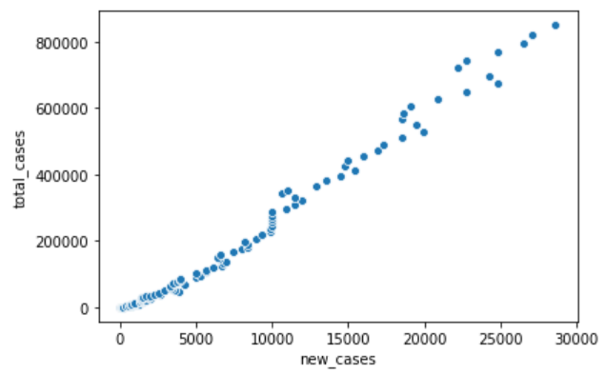
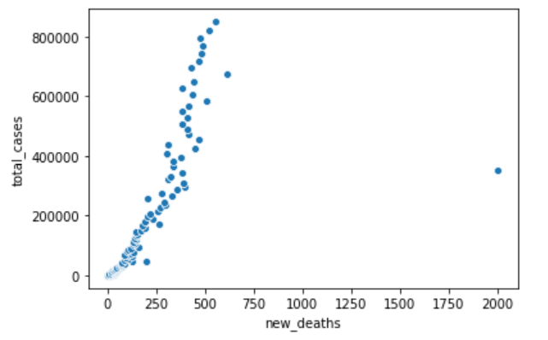
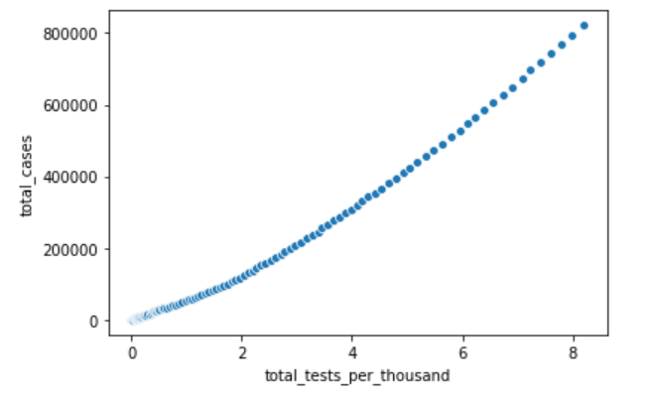
RESULTS CONCLUDED BY DOING BIVARIATE ANALYSIS
SCATTER PLOTS
Many features showed linear relation with the target column.
Some of the features were perfectly linear while others showed a best fit linear line can be drawn through the data points.
Some features like total tests per thousand and total tests, total tests and total deaths showed very similar relation in the scatter plots with the target column indicating they are directly proportional quantities

Slide 5
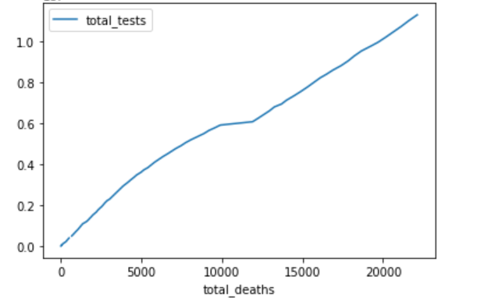
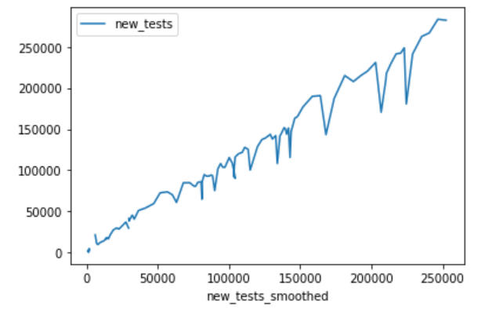
2. LINE PLOTS
Features like total tests and total deaths showed perfect correlation when represented as line plot which indicated any 1 of them could be dropped while constructing . But, other features like new tests and total tests didn’t show much correlation.

Slide 6
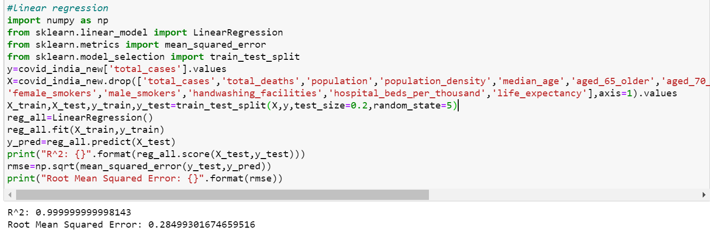
LINEAR REGRESSION CODE SNIPPET

Slide 7
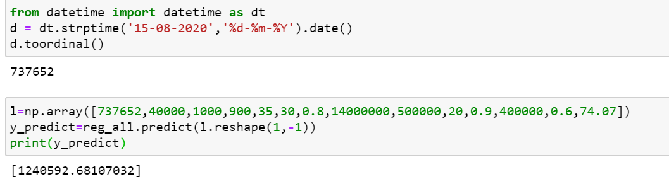
The features dropped for linear regression model are total_cases,total_deaths,population,population_density,median_age,aged_65_older, aged_70_older,gdp_per_capita,extreme_poverty,cvd_death_rate,diabetes_prevalence, female_smokers,male_smokers,handwashing_facilities,hospital_beds_per_thousand, life_expectancy.
The prediction done by the model for a particular date and entered features is given below:

